Slide 1
FROM DESIGN CHALLENGE TO WALKWISE
How might we make it easier for working adults to incorporate outdoor movement into their daily routines?
OUR HUMAN-CENTRED DESIGN JOURNEY
1
Frame
2
Research
3
Listen
4
Ideate
Define the question and working adults as the target group.
Evidence suggests even modest movement and outdoor time can support wellbeing.
Our survey indicates walking is the preferred form of outdoor movement.
Explore high-impact, low-effort ways to add movement to the workday.
5
Learn
6
Refine
7
Pitch
Pitch feedback highlights the importance of visible senior leadership support.
Develop the concept and an AI-assisted prototype using structured prompts.
WalkWise is ready as a hypothetical proposal for senior management.
Notes:
This introductory slide is for the university group rather than the hypothetical senior-management audience. Briefly explain the progression from the original “How might we” question to the refined WalkWise concept. The timeline shows how research, user input, ideation, feedback and prototyping shaped the final pitch.
[Sources]
- Research summary and project milestones provided by the project team.

Slide 2

WALKWISE
Make movement
part of the workday.
Turn suitable meetings into optional, walk-friendly moments that benefit both colleague wellbeing and workplace culture.
A small calendar cue.
A supportive workplace norm.
A healthier way to work.
Notes:
Transition clearly: from this point onwards, the presentation becomes the hypothetical pitch to senior management.
[Sources]
- Visual on this slide was generated with Microsoft Copilot.

Slide 3
WalkWise — Rethinking the Workday - HCD

Slide 4

01 | THE HUMAN OPPORTUNITY
Bring movement into the moments where it naturally fits.
Working adults often want more movement and outdoor time. WalkWise enables both through suitable meetings.
8:30
“Where could movement fit today?”
09:00
Stand-up
11:00
Project catch-up
13:00
Quarterly review
16:30
Project sync
The opportunity: add movement to suitable conversations already in the calendar.
Notes:
A full day of work, commuting and personal responsibilities can leave few convenient openings for movement. WalkWise uses selected, conversation-based meetings differently.
[Sources]
- Visual on this slide was generated with Microsoft Copilot.

Slide 5
02 | WHY THIS IS WORTH EXPLORING
Movement and time in nature are linked to meaningful health benefits.
WalkWise translates this research into a simple workplace option: move during a suitable meeting, without adding another task to the day.
18%
120
≈2.6k
lower depression risk
minutes in nature / week
steps / day
at around 75 minutes of activity per week, compared with no activity
threshold associated with a higher likelihood of good health and wellbeing
level from which significant mortality risk reductions were observed
A HEALTHY OPTION, BUILT INTO THE WORKDAY
Visible leadership support can help make walking meetings a comfortable, practical choice when the format allows.
Sources: Pearce et al. (2022); White et al. (2019); Stens et al. (2023). Associations do not prove workplace productivity effects.
Notes:
Use the evidence without overclaiming. The research links physical activity and nature exposure with health outcomes.
[Sources]
- Pearce et al. (2022): https://pubmed.ncbi.nlm.nih.gov/35416941/
- White et al. (2019): https://www.nature.com/articles/s41598-019-44097-3
- Stens et al. (2023): https://pubmed.ncbi.nlm.nih.gov/37676198/

Slide 6
03 | THE SOLUTION
WalkWise guides users from opportunity to choice
It identifies conversation-based meetings, enables organisers to mark them walk-friendly, and gives participants the choice to walk or join from their usual workspace.
WalkWise calendar
1
Suggest
Calendar identifies a conversation-focused meeting.
1 WALK OPPORTUNITY
9:00
Team stand-up
2
Check
Organiser confirms no screen or sustained typing.
Regular meeting
11:00
Project catch-up
Walk opportunity ›
3
Invite
Attendees see a clear, optional walk-friendly cue.
1:00
Quarterly review
Shared screen
4
Choose
Walk together, walk solo, or join as usual.
Explore walking
Walk if you wish, stay at your desk if you prefer. The choice is yours.
Notes:
WalkWise acts when a meeting is created. It checks whether audio-only participation is suitable and communicates the choice clearly.
[Sources]
- Prototype concept and wording provided by the project team.

Slide 7

04 | THE IDEA TO CARRY FORWARD
A small change to the calendar.
A meaningful change to the workday.
WalkWise makes movement easier to choose by placing it inside selected meetings, while keeping participation flexible and entirely optional.
FOR
COLLEAGUES
More opportunities to move, spend time outdoors and shape the workday around personal needs.
FOR
THE ORGANISATION
A practical way to support wellbeing and strengthen a flexible, people-centred meeting culture.
WITH
LEADERSHIP SUPPORT
A visible signal that walking meetings are welcomed when the meeting format makes them appropriate.
WALKWISE | MAKE MOVEMENT PART OF THE WORKDAY
Notes:
End by reinforcing the concept rather than requesting a decision.
[Sources]
- Visual on this slide was generated with Microsoft Copilot.

Slide 8
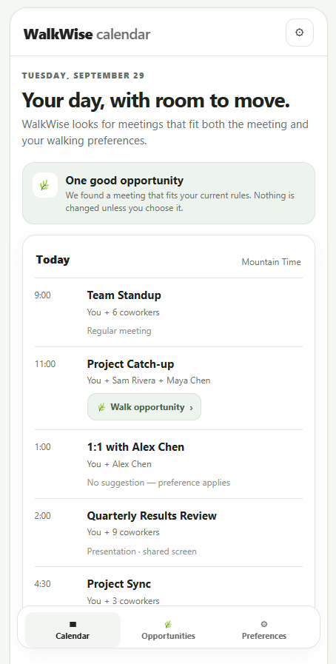

See WalkWise in action through a typical meeting journey

